Slide 1
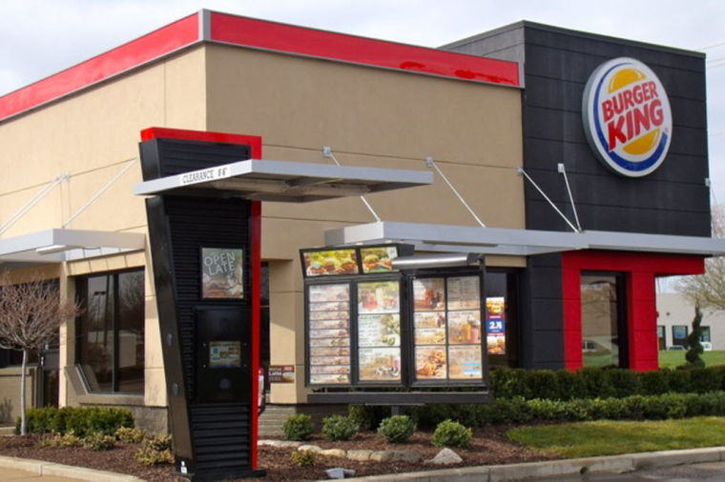
BURGER KING RESTAURANT
Notes:
Burger king restaurant is among popular brands that sell fast foods such as burgers

Slide 2
INTRODUCTION
Waiting for too long
Burger not same size and quality as advertised
Notes:
When I went to buy a burger, I had to wait for twenty minutes than the less than the normal five minutes they had indicated. The second problem was that what I ordered was less in size and of poor quality than what was advertised.

Slide 3
OBJECTIVE
Waiting for too long
https://www.youtube.com/watch?v=AFpmXqPyrdY
Burger not same size and quality as advertised
https://www.youtube.com/watch?v=XrZFM2nvLXA
Notes:
I had to wait for so long before I was served because there were very few personnel serving and even after being served I realized that the burger I was given was small in size and of poor quality.

Slide 4
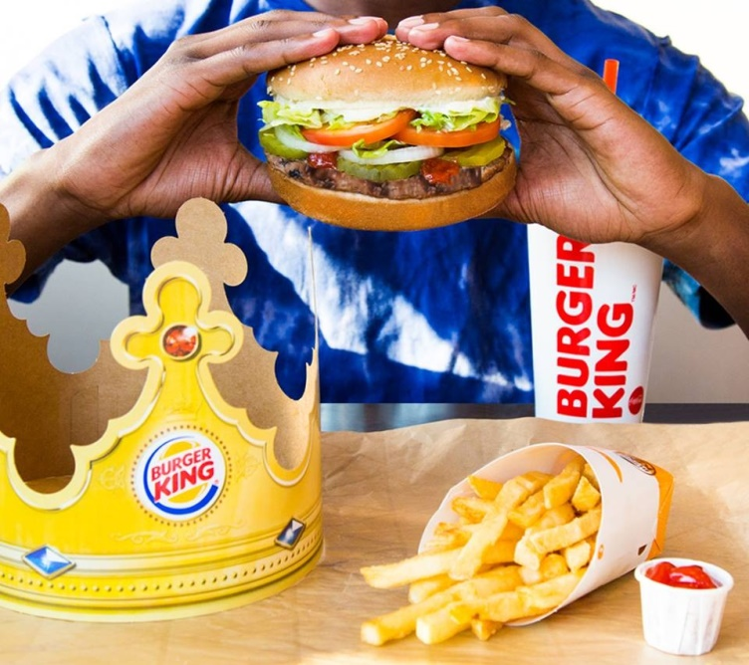
SOLUTION
Faster service delivery
Good quality burgers
Notes:
An increase in the number of those people serving customers hence quick customer service and an increase in sizes and quality of the burgers

Slide 5
DMAIC
Define: waiting for too long and burger not same size as advertised
Measure: less working personnel
Analyze: many customers flocking in for the burgers
Improve: Increase the number of working personnel and quality of burgers
Control: listening to customer complaints and improving in service delivery
Notes:
There was poor service delivery at the Burger King restaurant due to less working personnel, the problem was solved when more working personnel were hired after I made the complaint to the management.

Slide 6
CONCLUSION
Increase the number of personnel
Increase the sizes and quality of burgers
Notes:
The management listen to their customers and improve on their services.

